Slide 1
BLOG NAME:
UNIQUE THREE

Slide 2
CATEGORY:
DIGITAL MARKETING

Slide 3
EMAIL: uniquethree4@gmail.com

Slide 4
WORD PRESS BLOG URL: https://friendship75.wordpress.com/2023/10/31/unique-three/

Slide 5
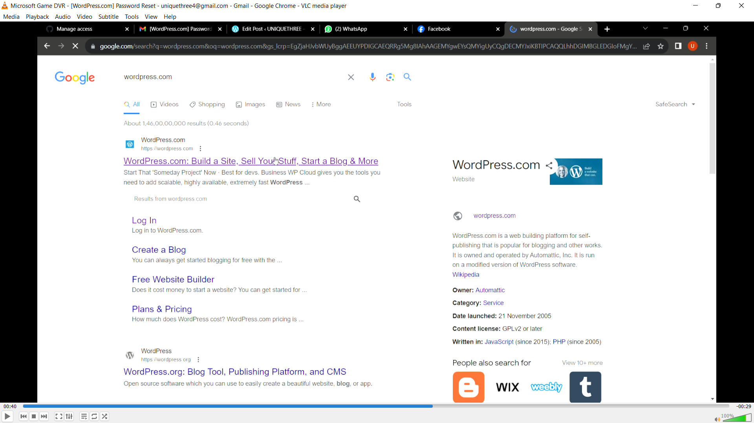
1)OPEN WORDPRESS.COM IN CHROME OR ANY OTHER

Slide 6
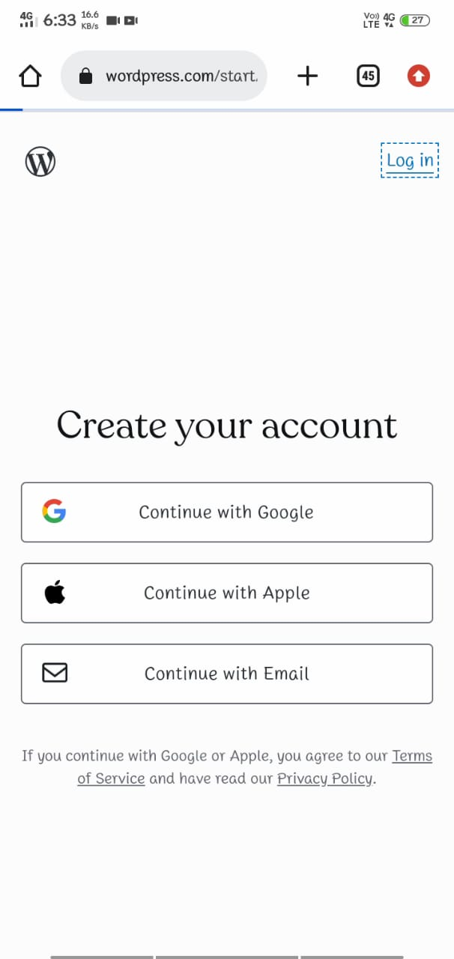
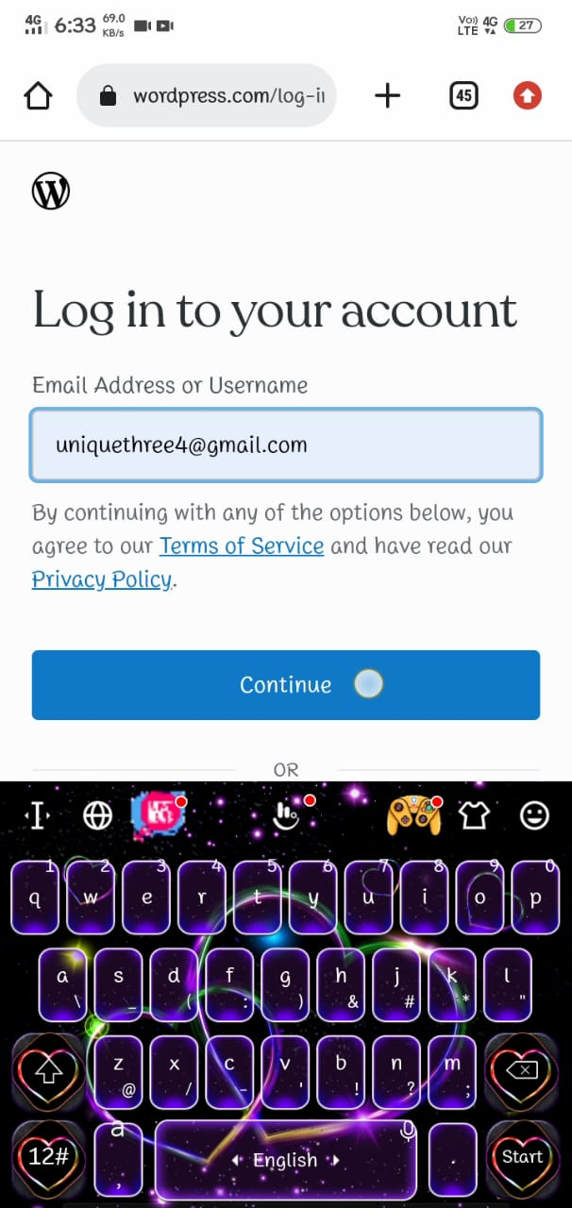
2)LOG IN OR SIGN UP TO WORDPRESS

Slide 7
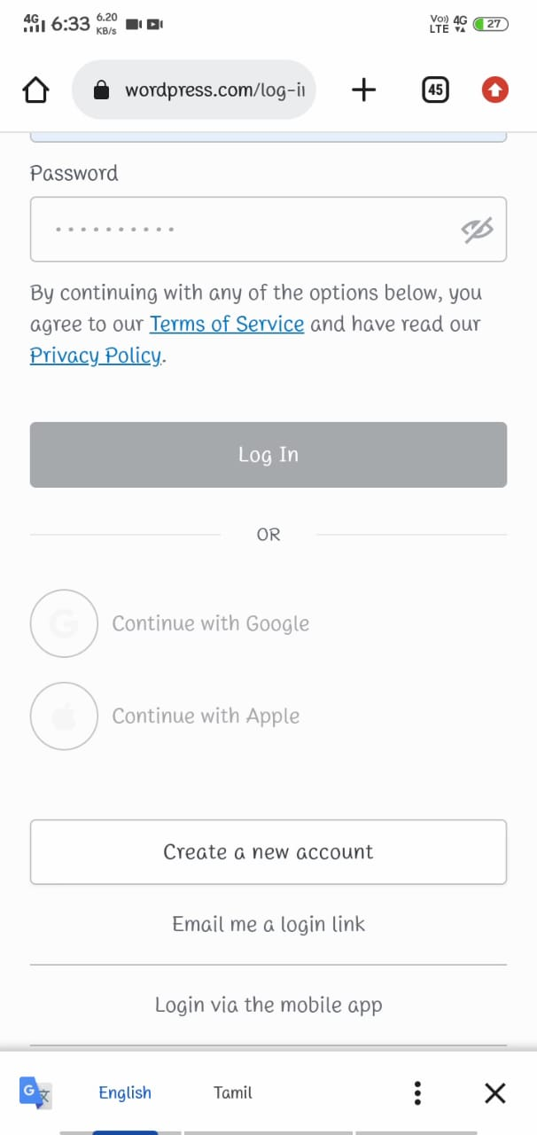
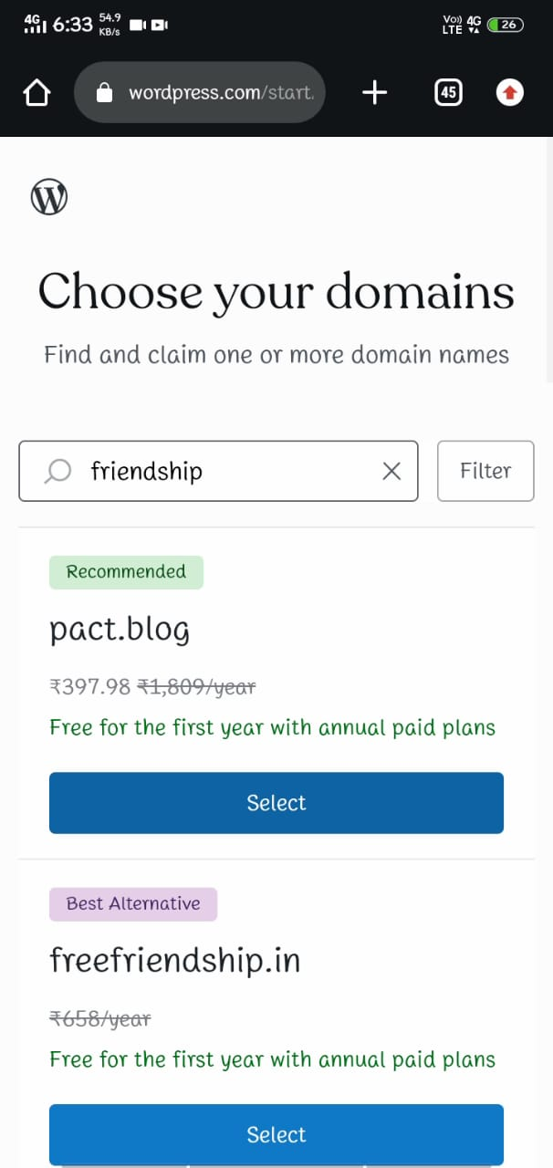
3)ENTER YOUR DOMAIN

Slide 8
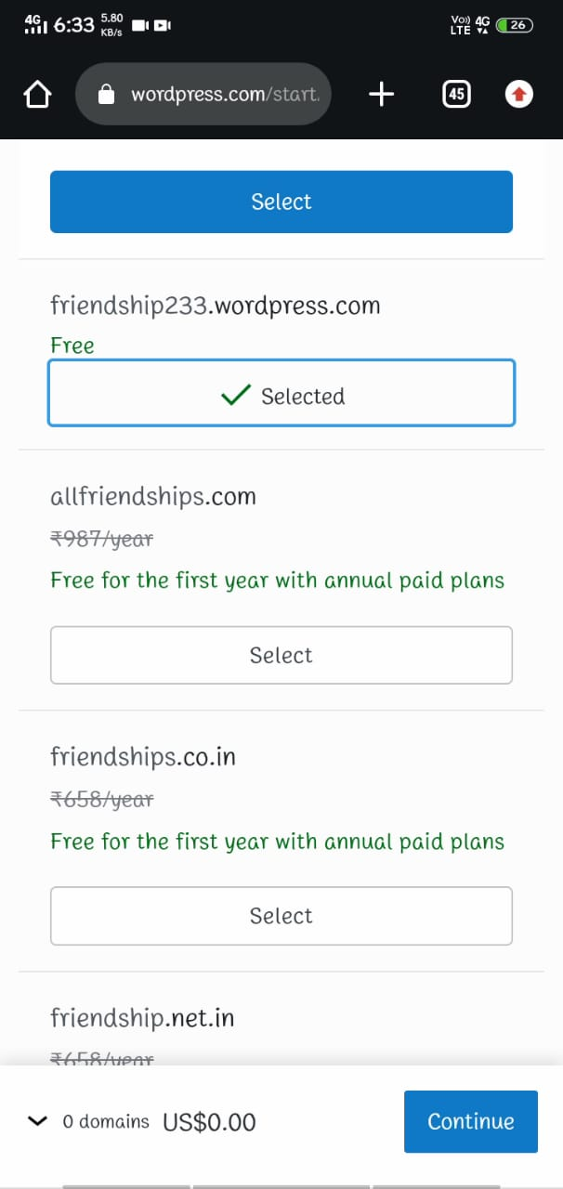
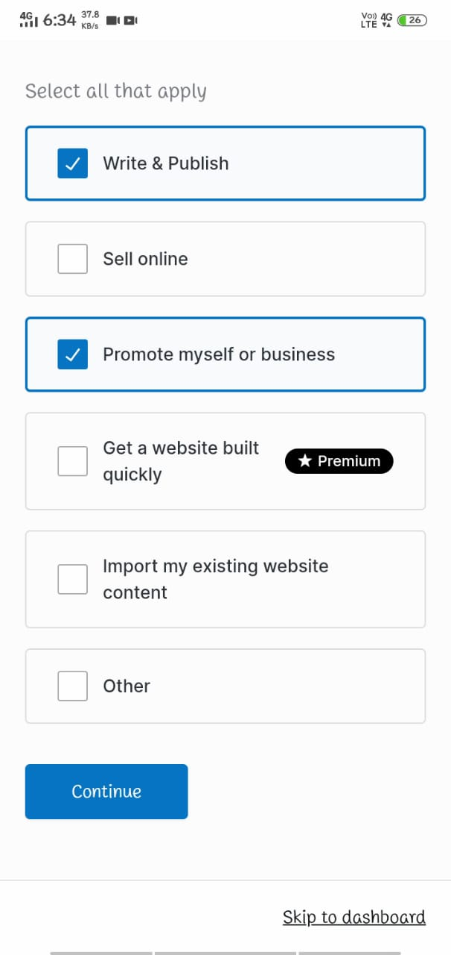
4)SELECT FREE DOMAIN

Slide 9
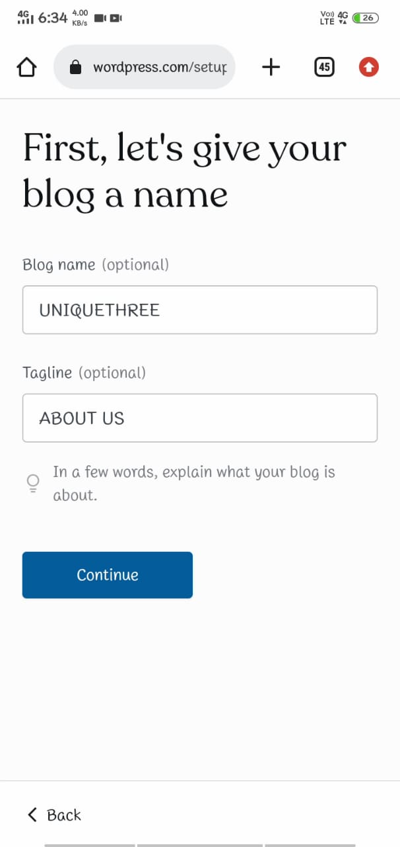
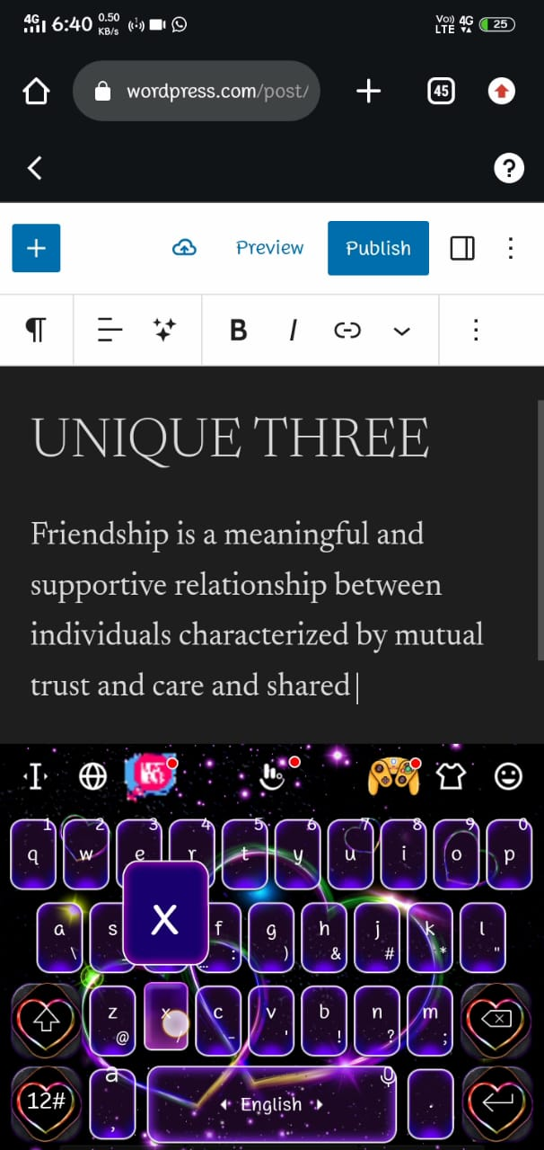
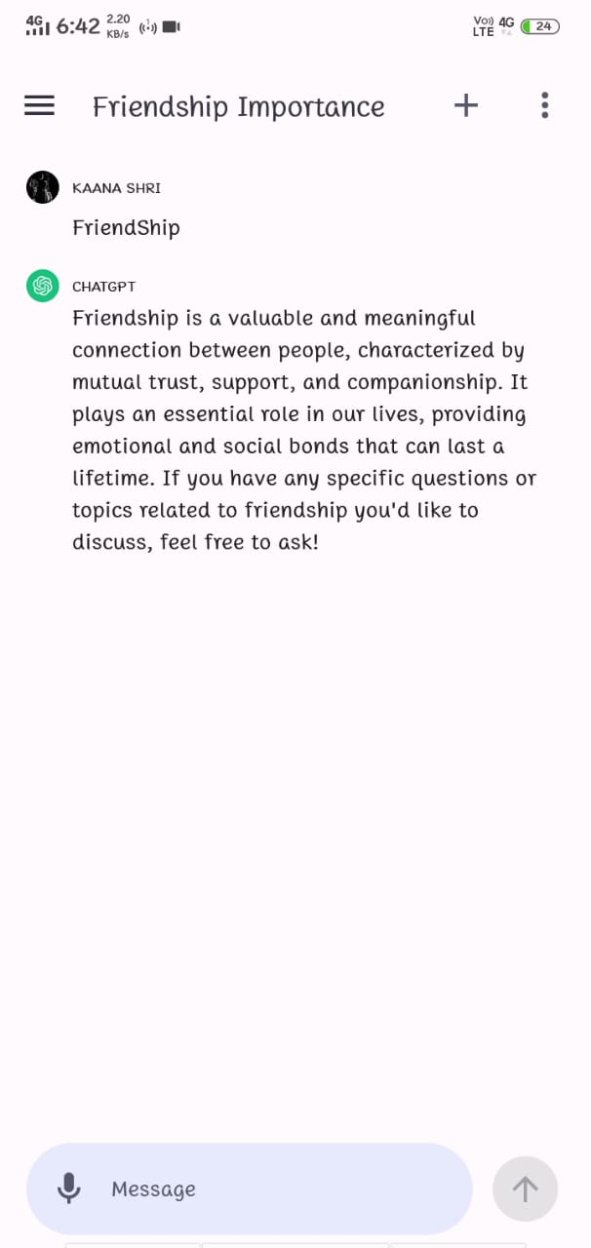
5)WRITE THE CONTENT ABOUT YOUR TOPIC

Slide 10
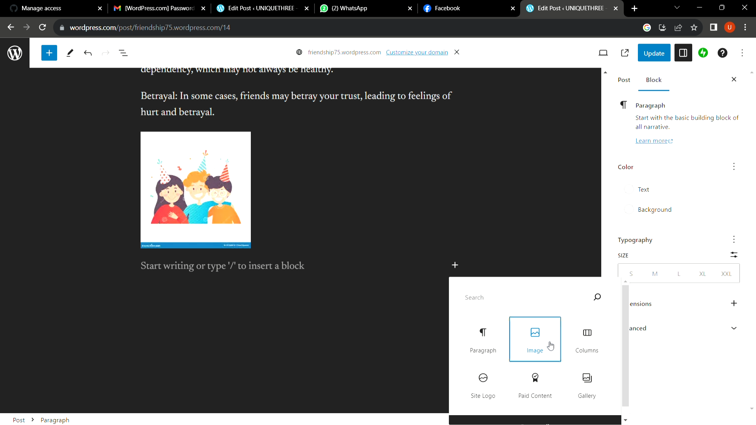
6)SELECT IMAGES FROM GALLERY

Slide 11
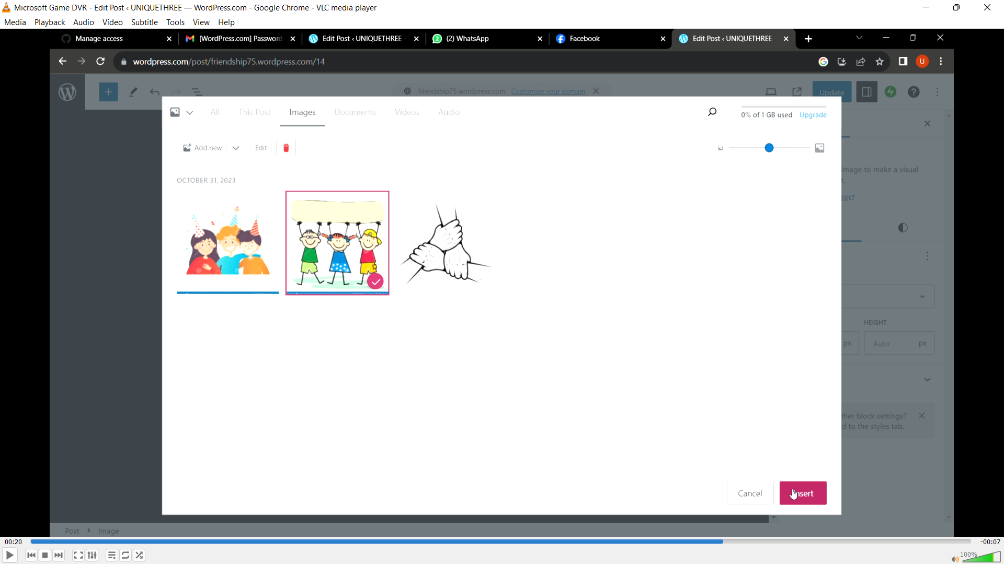
7)INSERT IMAGE TO BLOG

Slide 12
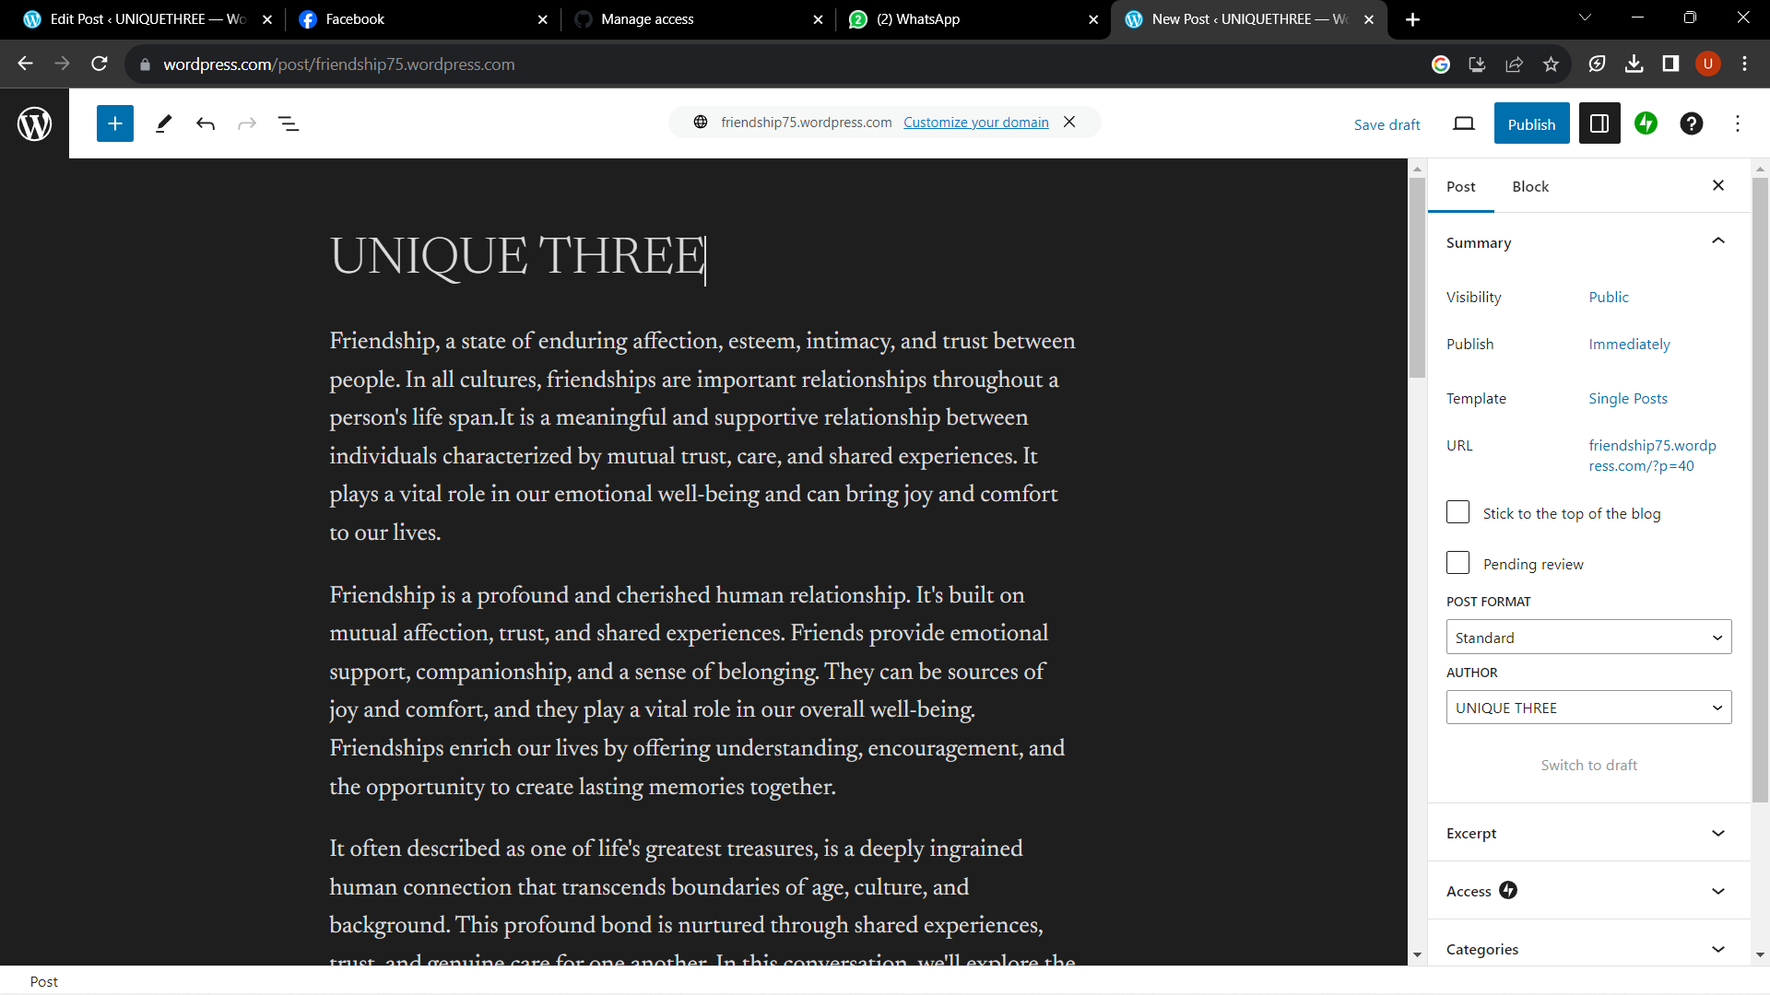
8)PUBLISH THE BLOG

Slide 13
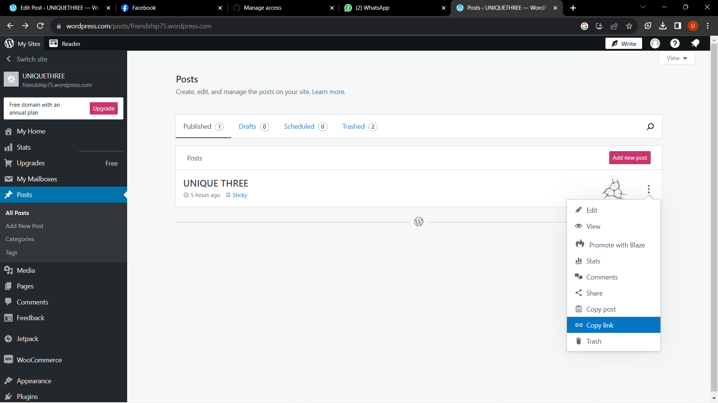
9)COPY THE LINK OF YOUR BLOG

Slide 14
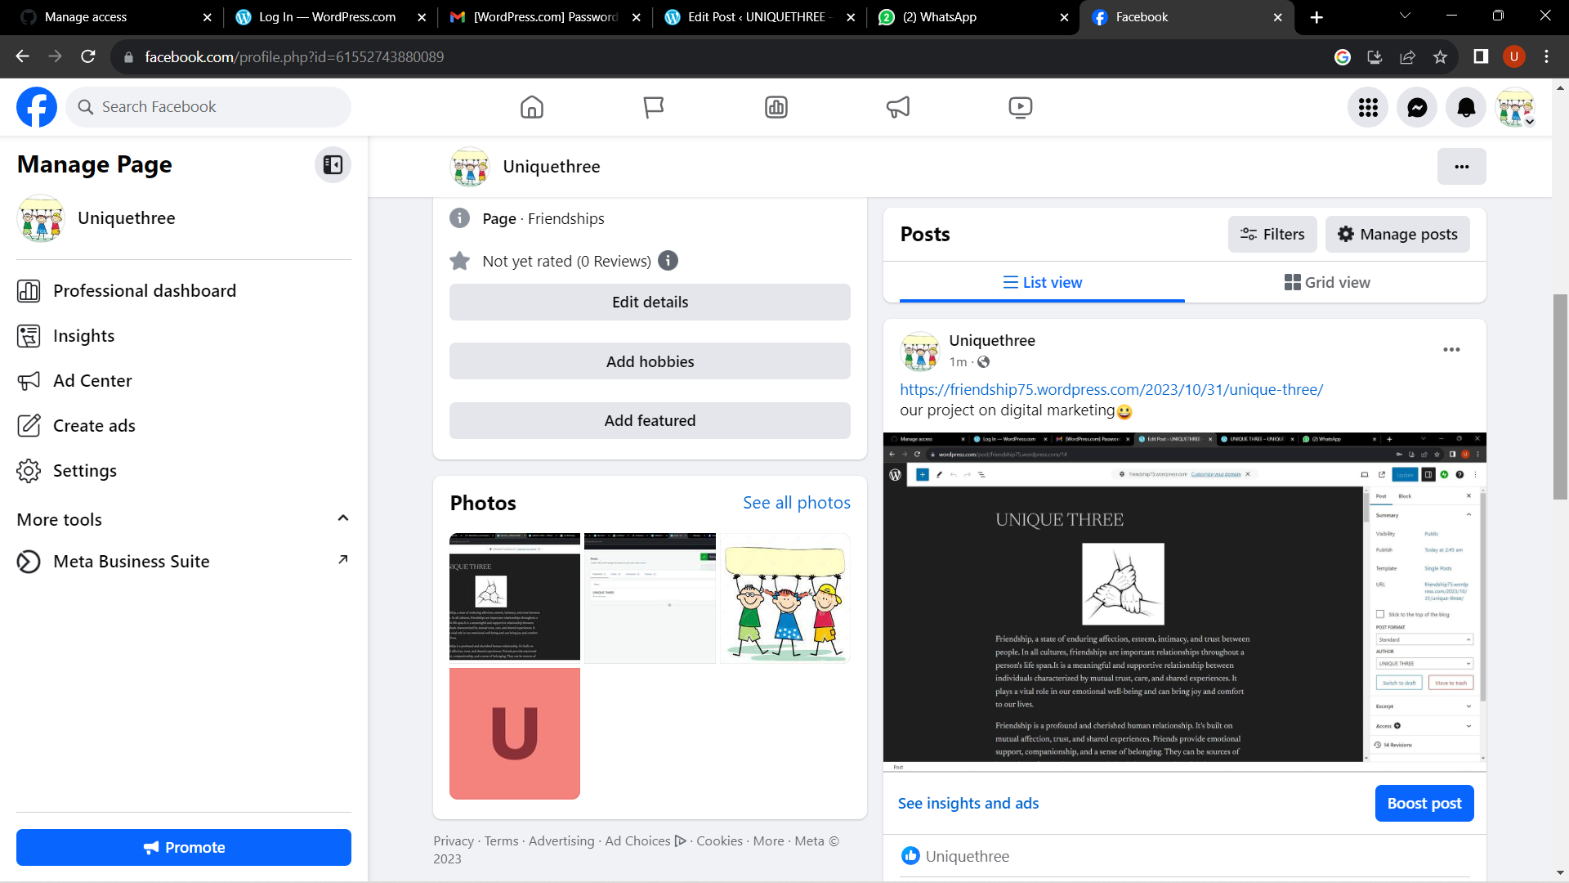
10)PASTE THE BLOG LINK IN SOCIAL MEDIA WITH A POST

